Slide 1

Text2text generation using GAN
Presented by- Group 06
Mukund Kumar 2006200
Prince Raj 2006185
Ayush Gautam 2006155
Under Supervision of
Dr. Jyoti Prakash Singh
Department of Computer Science & Engineering
National Institute of Technology, Patna

Slide 2
Content
Introduction
GAN model introduction
cGAN
Why cGAN?
Initial dataset
Workflow Diagram
Preprocessing
Why GloVe?
Final dataset
Accuracy
Future scope
Reference

Slide 3
Motivation
To remove the biases of a dataset by generating extra dataset.
To generate similar text.
Improvement of GAN model in the field of text generation.
Balancing of the dataset.

Slide 4
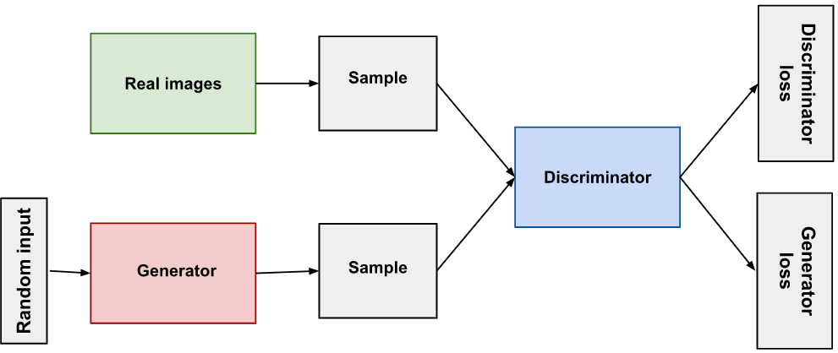
Generative Adversarial Network Model
The two neural networks(i.e Generator and Discriminator) that make up a GAN compete with each other to become more accurate in their predictions.

Slide 5
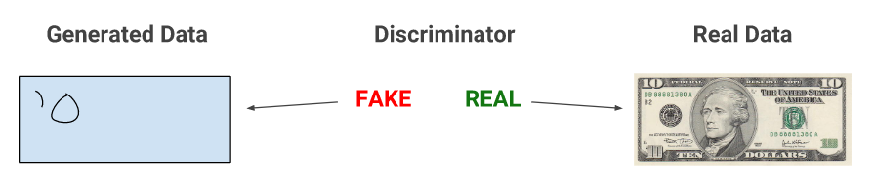
How does the GANs work ?
When training begins, the generator produces obviously fake data, and the discriminator quickly learns to tell that it's fake.

Slide 6
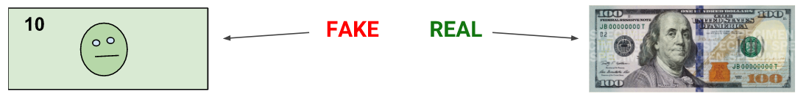
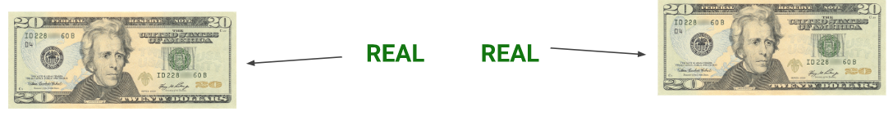
contd.
As training progresses, the generator gets closer to producing output that can fool the discriminator.
Finally, generator generates realistic example so that discriminator can’t discriminate.

Slide 7
Types of GAN
Some of the most popular type of GAN models:
Vanilla GAN
Conditional GAN (cGAN)
CycleGAN
Generative Adversarial text to image synthesis.
Style GAN
Super resolution GAN

Slide 8
cGAN
The Generator and Discriminator of the cGAN both receive some additional conditioning input information. This could be the class of the current image or some other property.
Adding a vector of features controls the output of the Generator

Slide 9
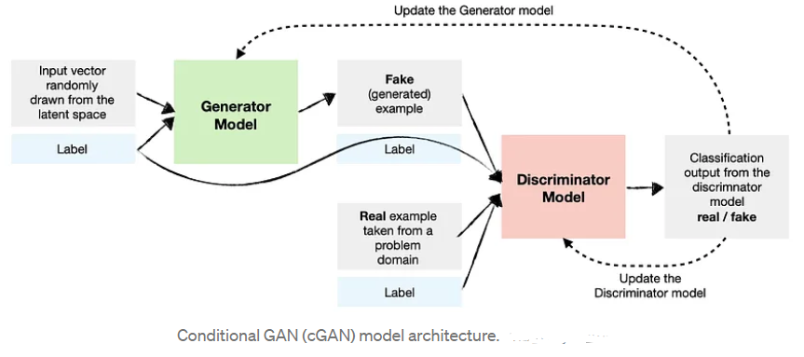
Architecture Diagram of the cGAN

Slide 10
Why Conditional Generative Adversarial Networks ?
As per our requirement, we need to generate dataset of some particular label, to decrease biasness in datasets that's why we require cGAN so that we can feed label as the condition input in cGAN.

Slide 11
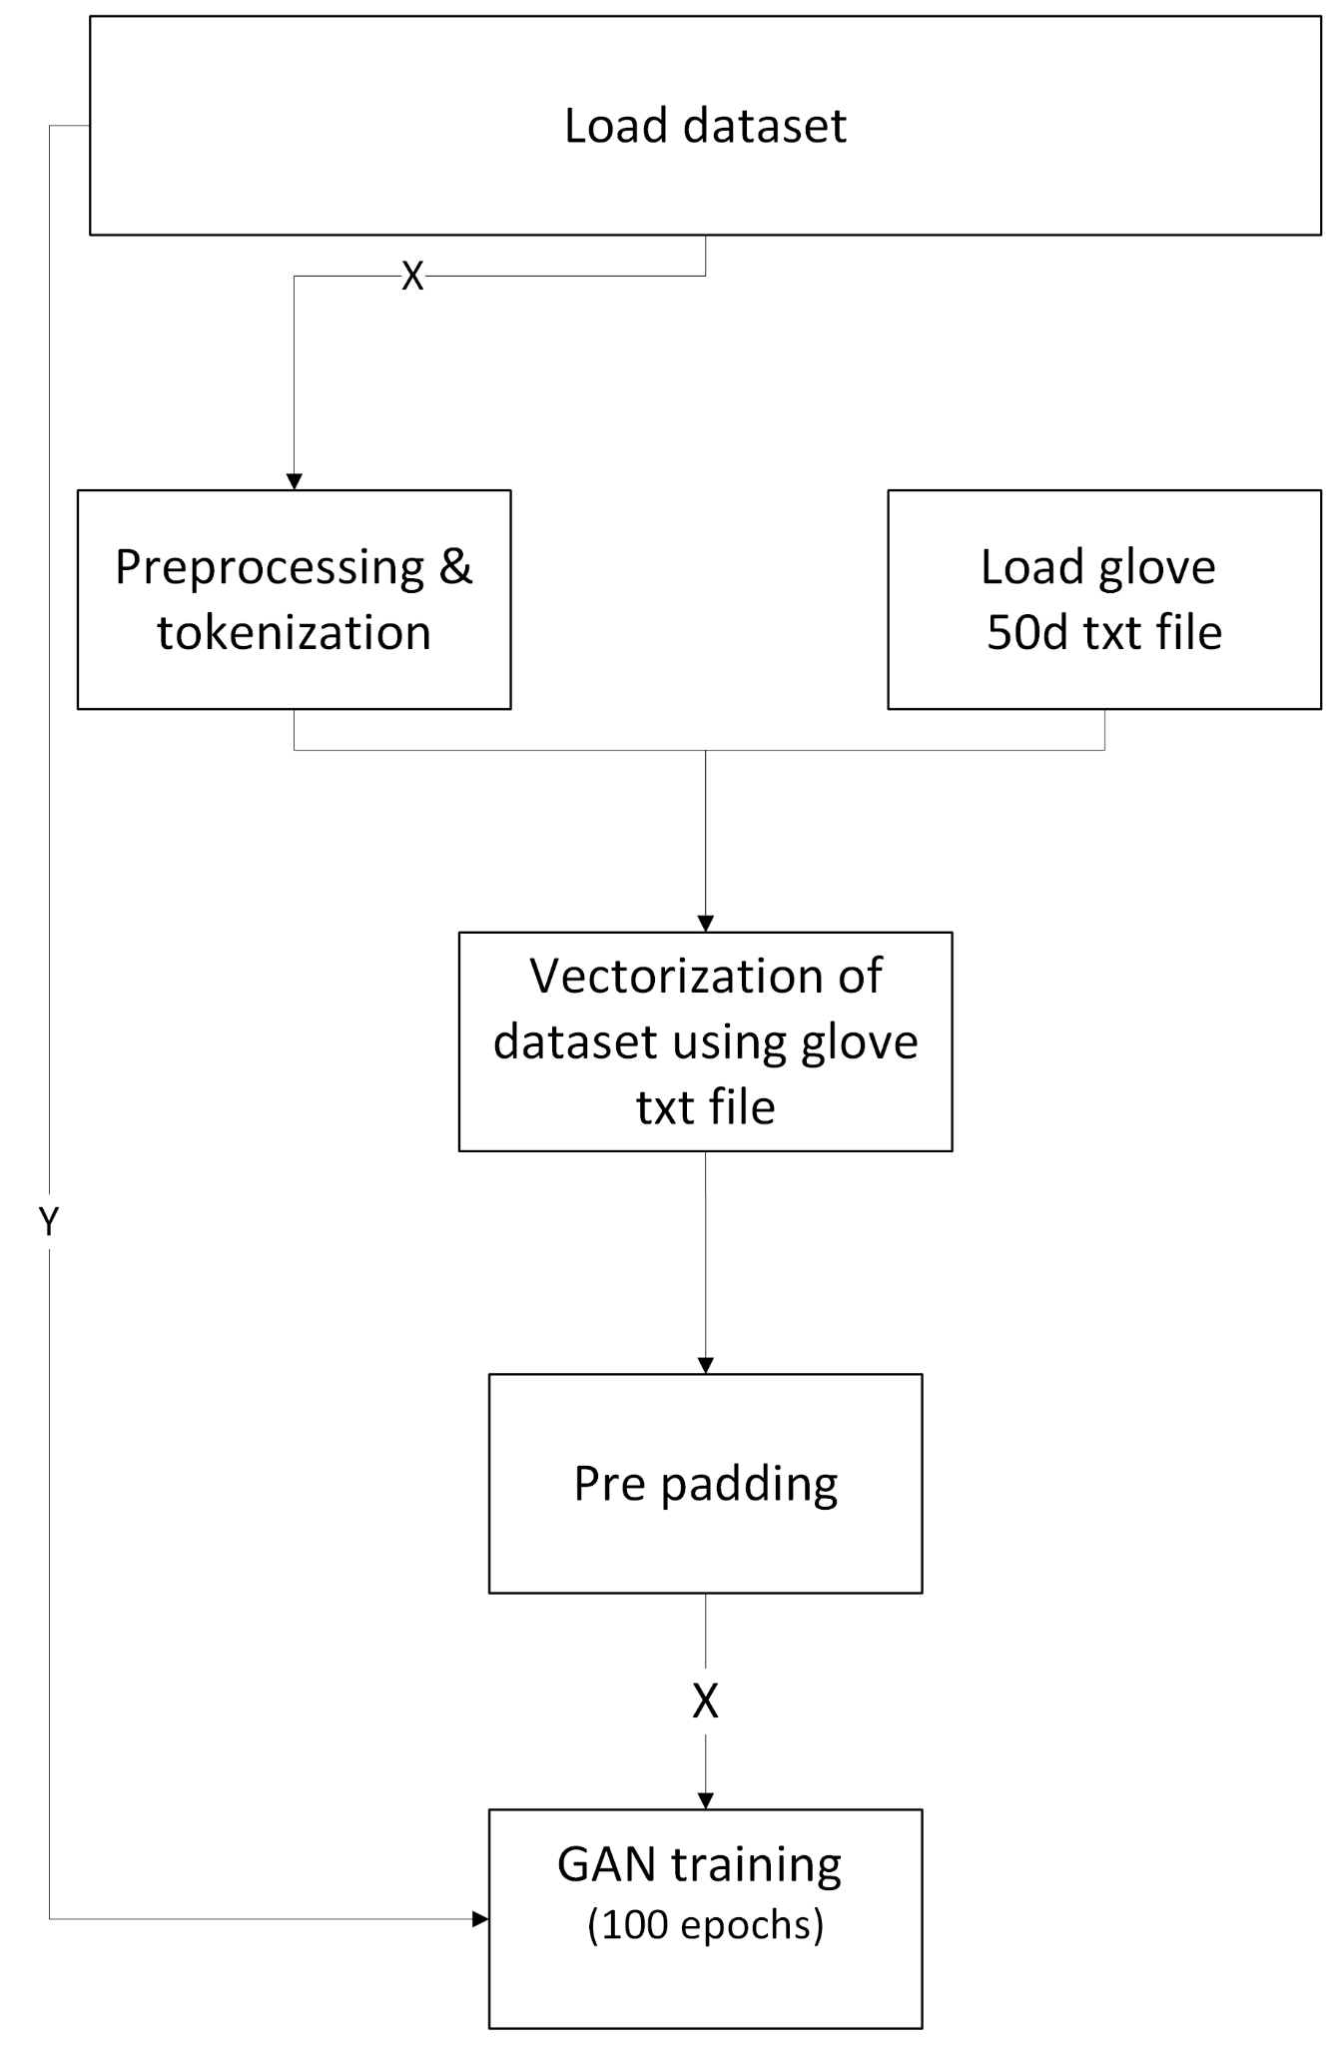
Workflow diagram

Slide 12
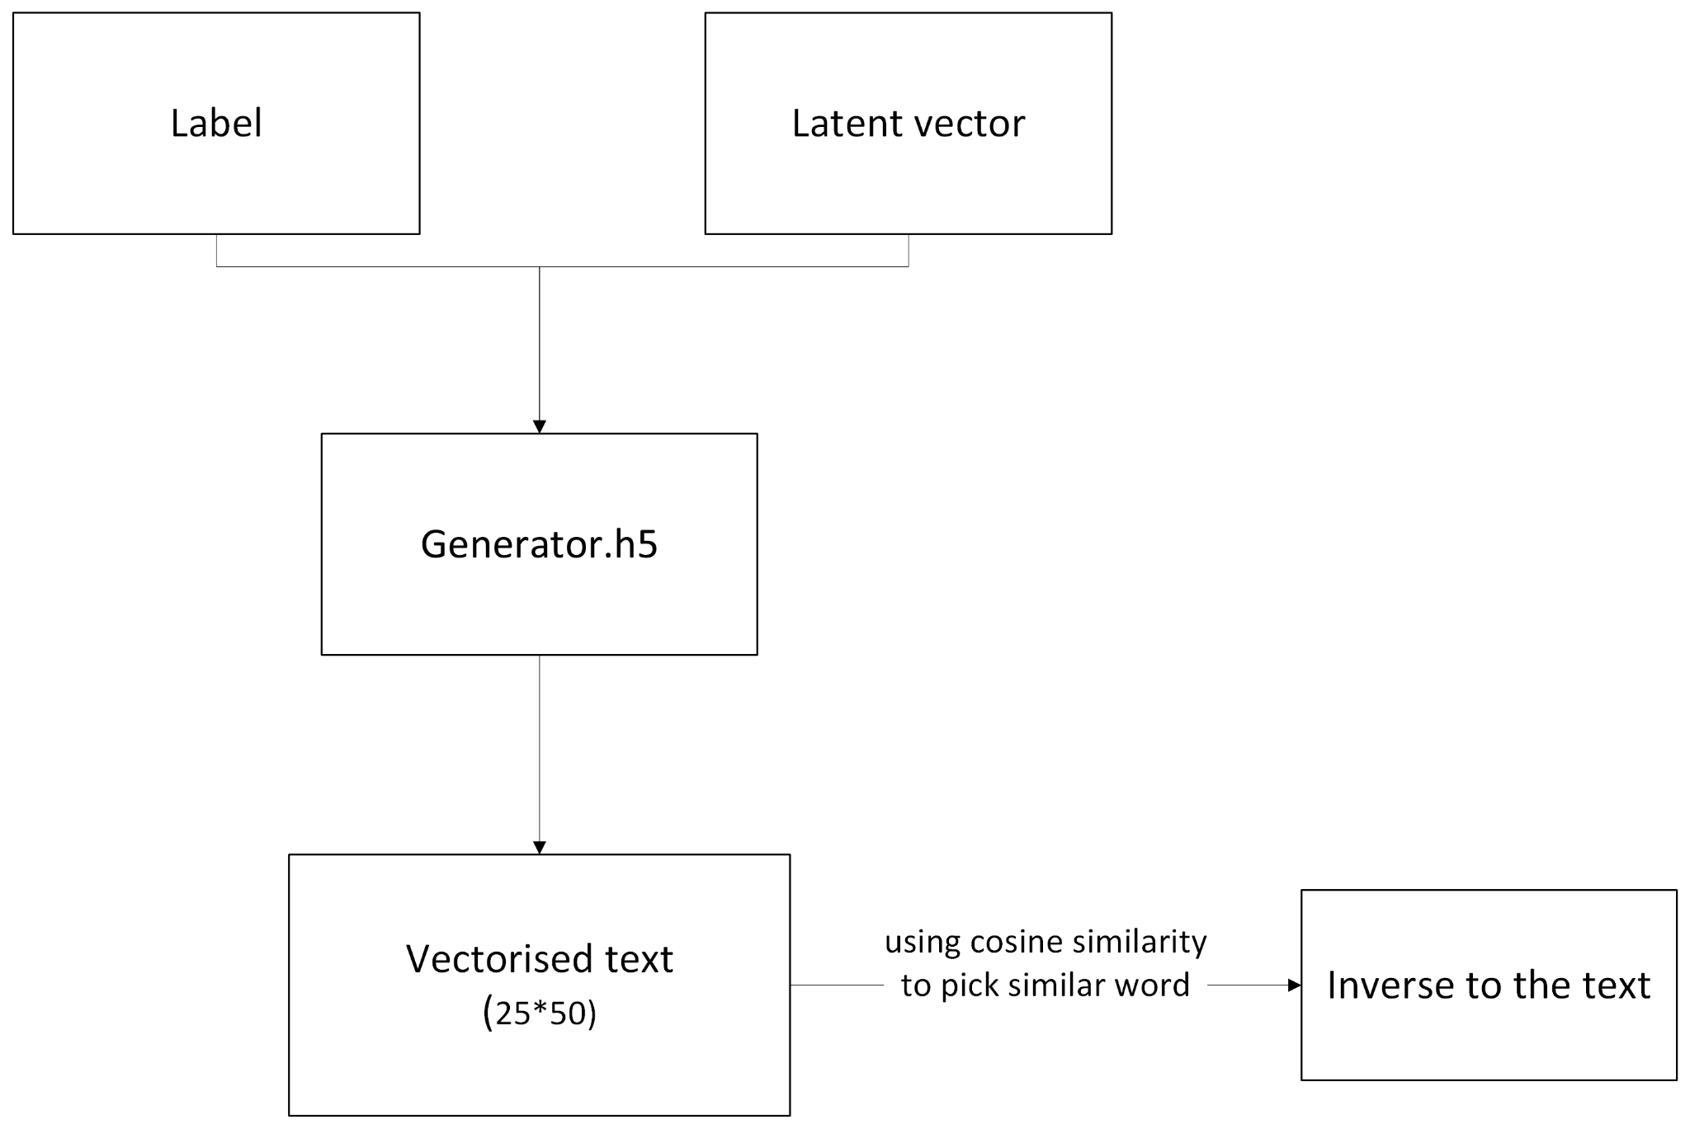
contd.

Slide 13
Preprocessing
Removal of usernames, links and unwanted texts and symbols.
Tokenizations
Lowering the tokens.
Lemmatization
Conversion of words into vectors using GloVe.

Slide 14
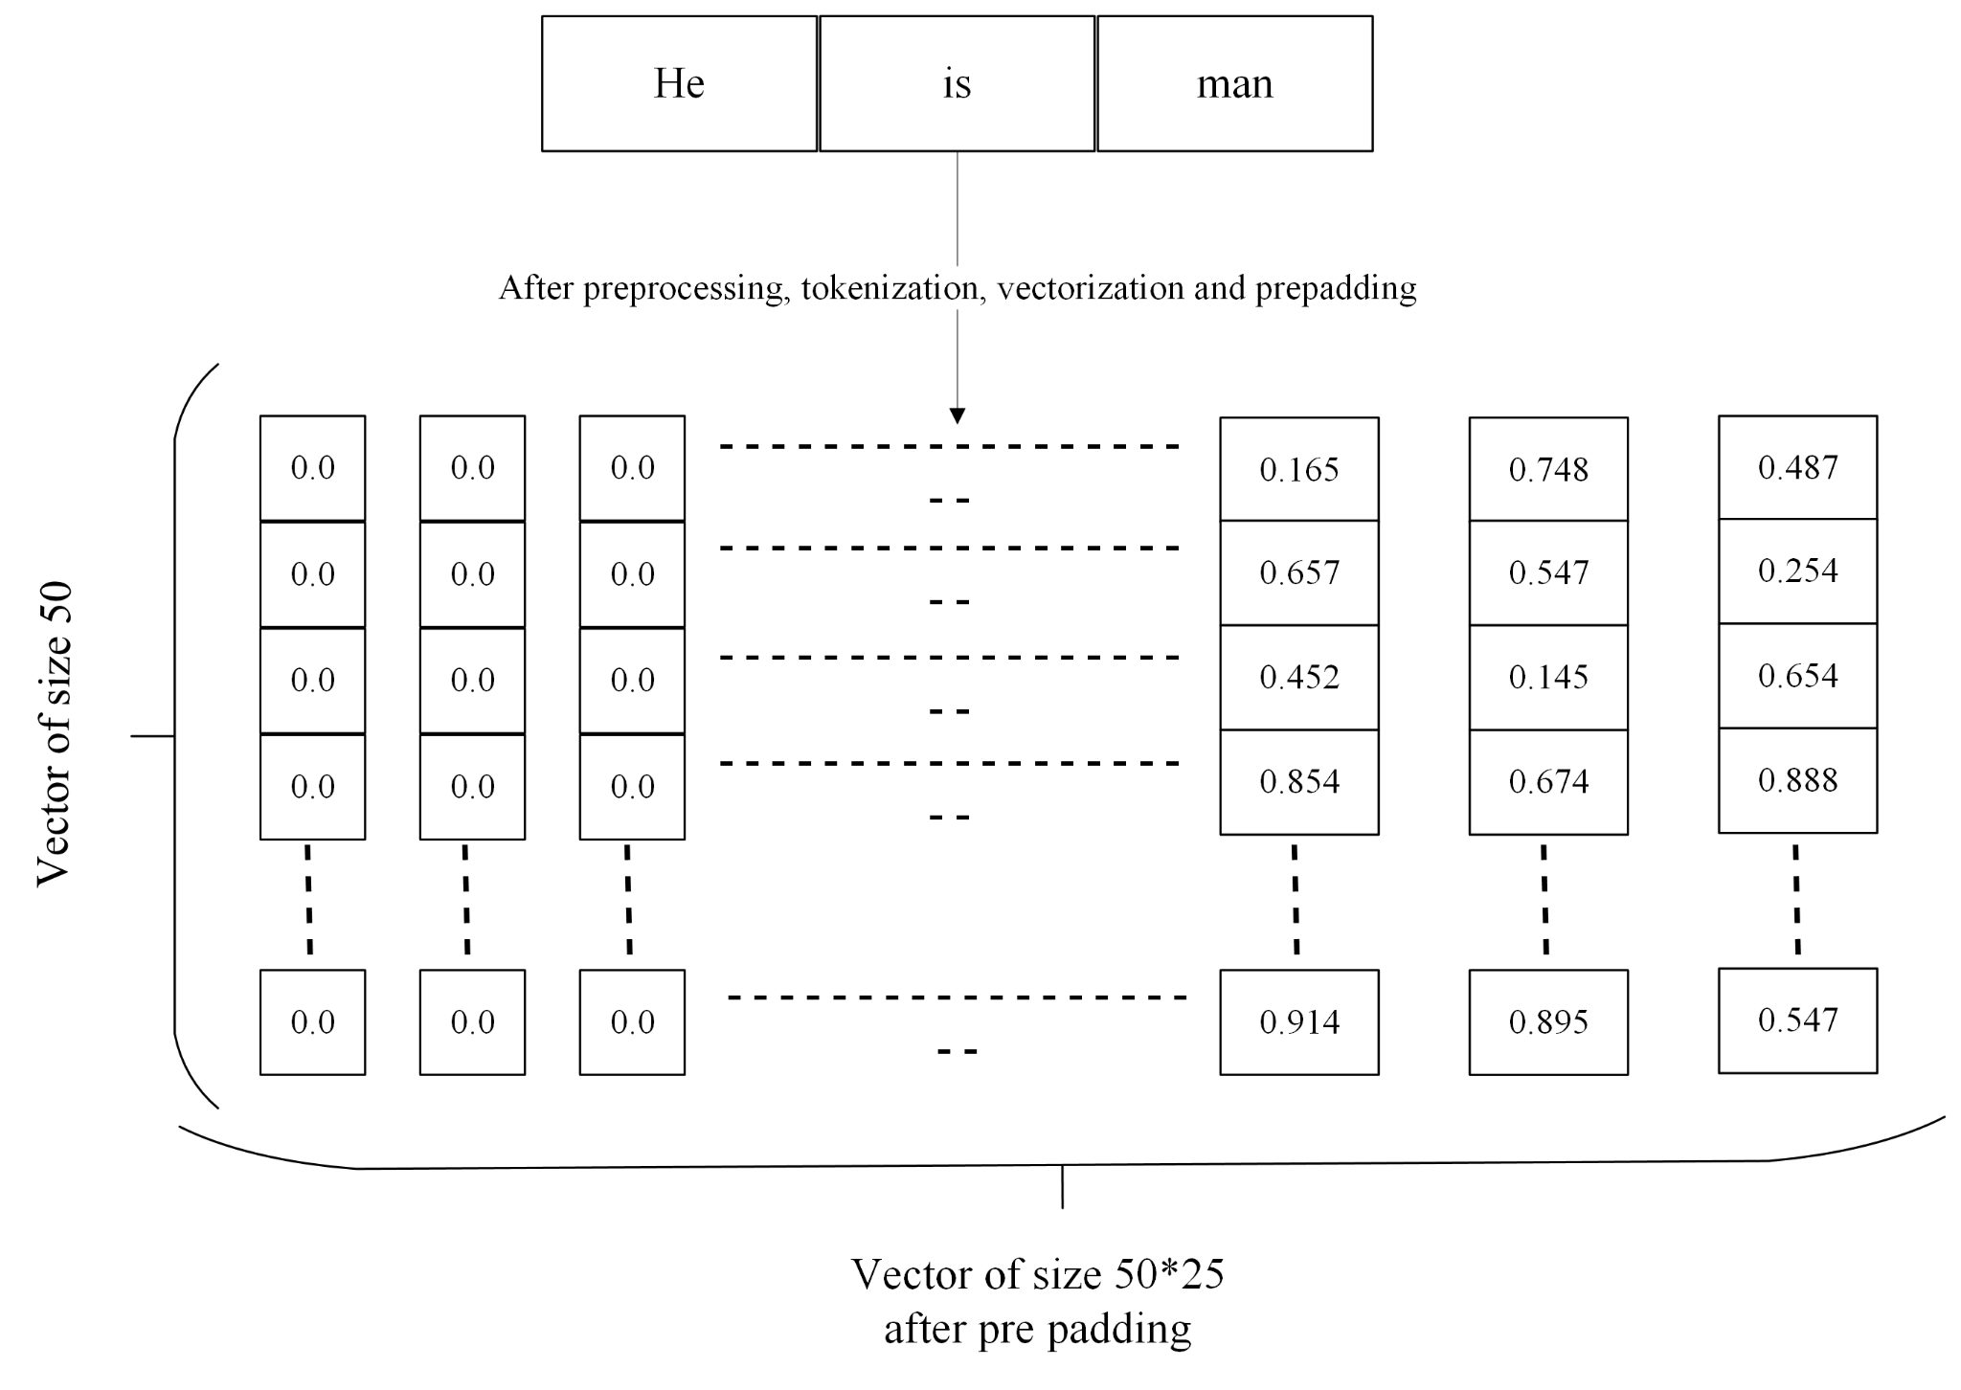
contd.

Slide 15
Why only GloVe?
GloVe perform better than Word2vec in the word analogy tasks.
GloVe gives lower weight for highly frequent word.
Stop the dominance of the stopword like ‘is’,’the’ , etc.

Slide 16
Dataset
Balance dataset using the developed cGAN model.
Equal no of dataset corresponding to each class of the data.

Slide 17
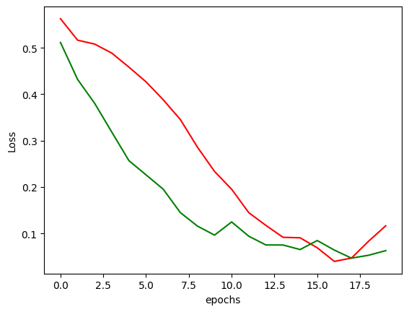
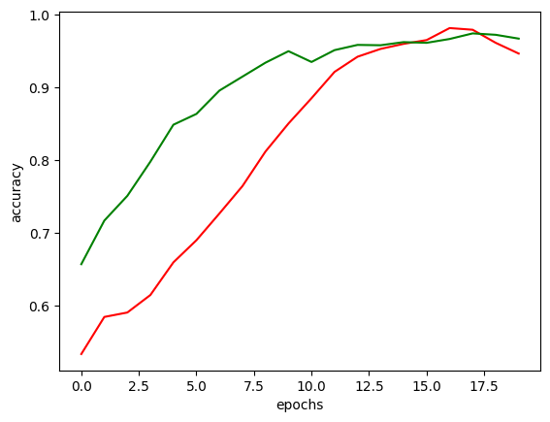
Accuracy improvement

Slide 18
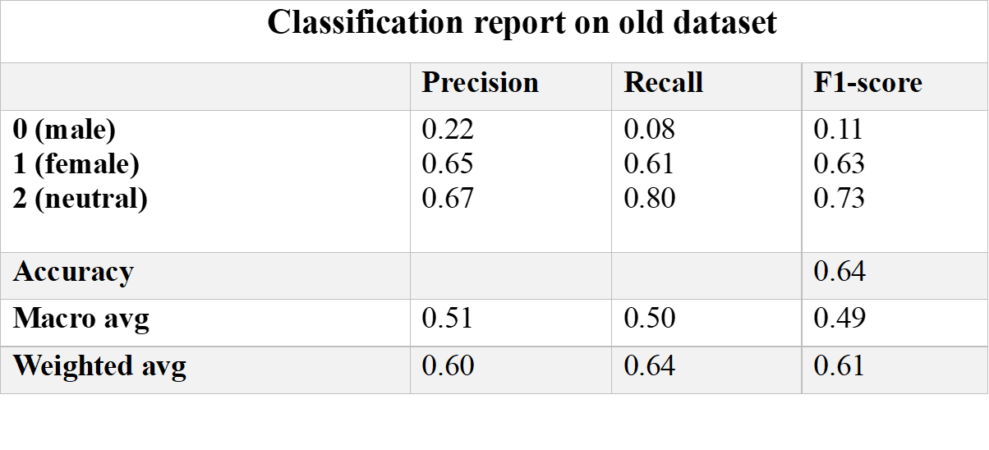
Classification Report

Slide 19
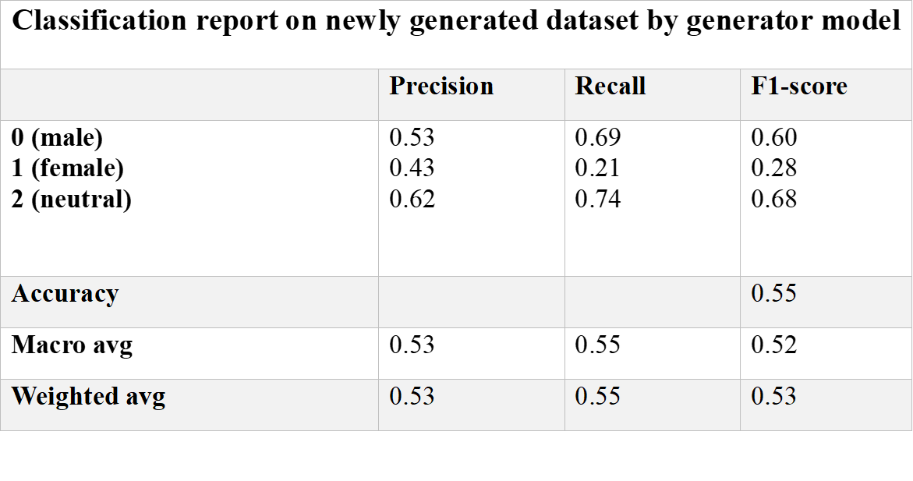
contd.

Slide 20
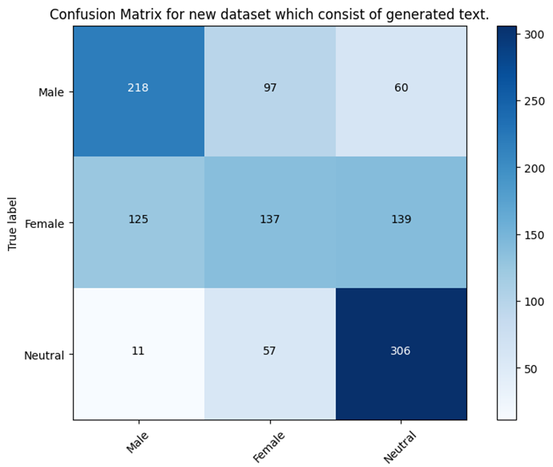
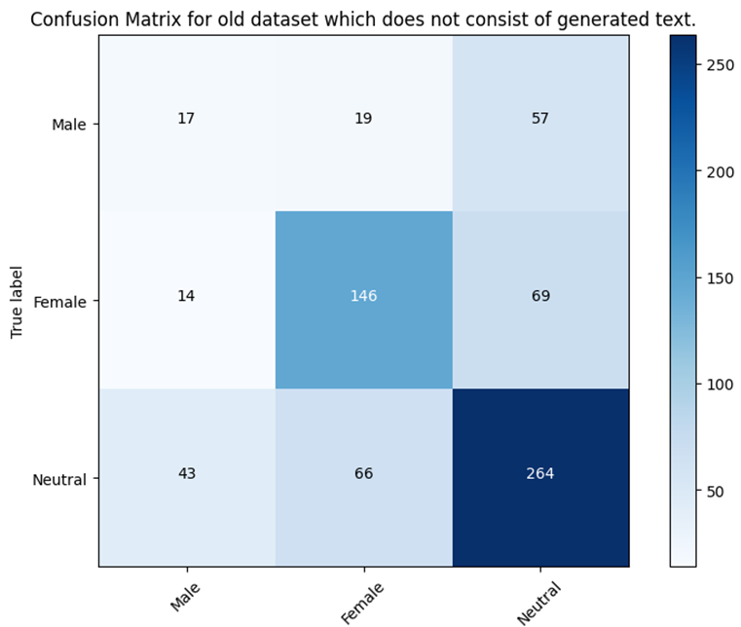
Confusion Matrix

Slide 21
Future Scope
Large scale implementation.
Multilingual text generation.
More accurate sentence prediction using Generator.
Grammatically correct sentence prediction.
Notes:
The new dataset will become the balance by using the model developed. The balance dataset will good for the further training of any model . In future

Slide 22
References
[1] Gu, Jiuxiang, et al. "Recent advances in convolutional neural networks." Pattern recognition 77 (2018): 354-377.
[2]. Dai, Bo, et al. "Towards diverse and natural image descriptions via a conditional gan." Proceedings of the IEEE international conference on computer vision. 2017.
[3]. Creswell, Antonia, et al. "Generative adversarial networks: An overview." IEEE signal processing magazine 35.1 (2018): 53-65.
[4]. Bishop, Chris M. "Neural networks and their applications." Review of scientific instruments 65.6 (1994): 1803-1832.
[5]. Traore, Boukaye Boubacar, Bernard Kamsu-Foguem, and Fana Tangara. "Deep convolution neural network for image recognition." Ecological informatics 48 (2018): 257-268.
[6]. Jmour, Nadia, Sehla Zayen, and Afef Abdelkrim. "Convolutional neural networks for image classification." 2018 international conference on advanced systems and electric technologies (IC_ASET). IEEE, 2018.
[7]. Pennington, Jeffrey, Richard Socher, and Christopher D. Manning. "Glove: Global vectors for word representation." Proceedings of the 2014 conference on empirical methods in natural language processing (EMNLP). 2014.

Slide 23
Contd..
[8].Kang, Yue, et al. "Natural language processing (NLP) in management research: A literature review." Journal of Management Analytics 7.2 (2020): 139-172.
[9]. Anandarajan, Murugan, et al. "Text preprocessing." Practical text analytics: Maximizing the value of text data (2019): 45-59.
[10]. Sharma, Yash, et al. "Vector representation of words for sentiment analysis using GloVe." 2017 international conference on intelligent communication and computational techniques (icct). IEEE, 2017.
[11]. Liu, Steven, et al. "Diverse image generation via self-conditioned gans." Proceedings of the IEEE/CVF conference on computer vision and pattern recognition. 2020.
[12]. Carvalho, Diogo V., Eduardo M. Pereira, and Jaime S. Cardoso. "Machine learning interpretability: A survey on methods and metrics." Electronics 8.8 (2019): 832.

Slide 24
Thank You

